Slide 1
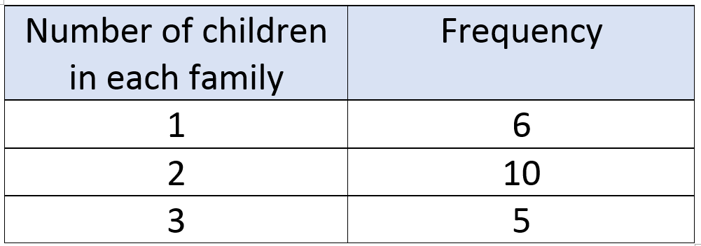
Numeracy strand:
Calculating the mean from a table
Exercise
The table below shows the number of children in different families. Work out the mean number of children in each family

Slide 2
Numeracy strand:
Calculating the mean from a table
Exercise
2) 100 people answered the survey
50 people gave a score of 2
40 people gave a score of 3
10 people gave a score of 4
What is the mean score?

