Slide 1
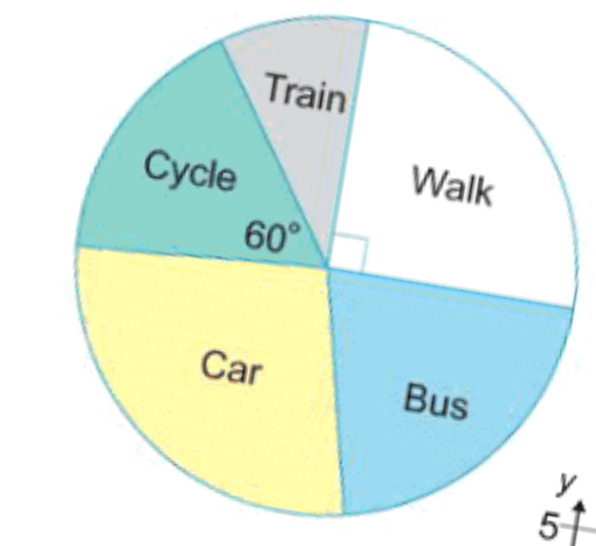
Numeracy strand:
Interpreting Pie Charts
Exercise
How people travel to work
If 30 people travel to work by car, how many people were asked?
How many people walk to school?

Slide 2
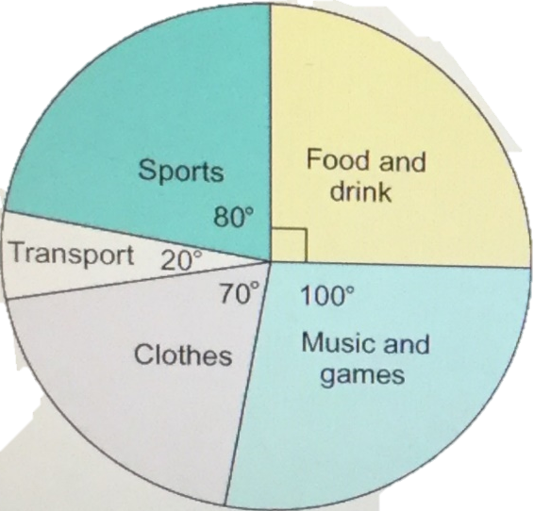
Numeracy strand:
Interpreting Pie Charts
Exercise
How Lauren spent her pocket money
Lauren spent £16 on Sports. How much pocket money does Lauren get?
How much does Lauren spend on Food and Drink?

