Slide 1
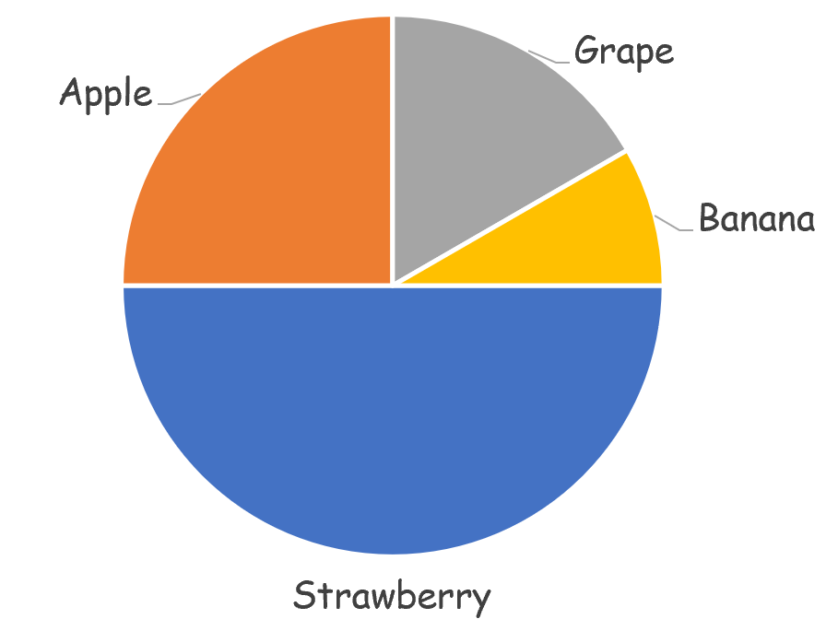
Numeracy strand:
Interpreting Pie Charts
Example
Pie chart to show favourite fruit
30 pupils chose Strawberry, how many pupils were asked?
A quarter of those asked chose grapes. Twice as many people chose apple than banana. How many people chose apple?

