Slide 1
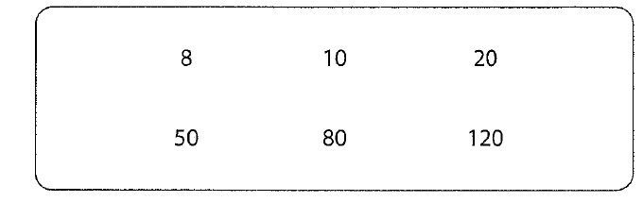
Numeracy strand:
Finding multiples
Exercise
1) Circle all the multiples of 40 2) Write down 2 multiples of 8

