Slide 1
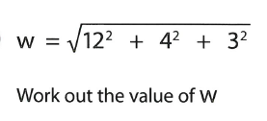
Numeracy strand:
Solving problems involving roots
Example
1)
2)

