Slide 1
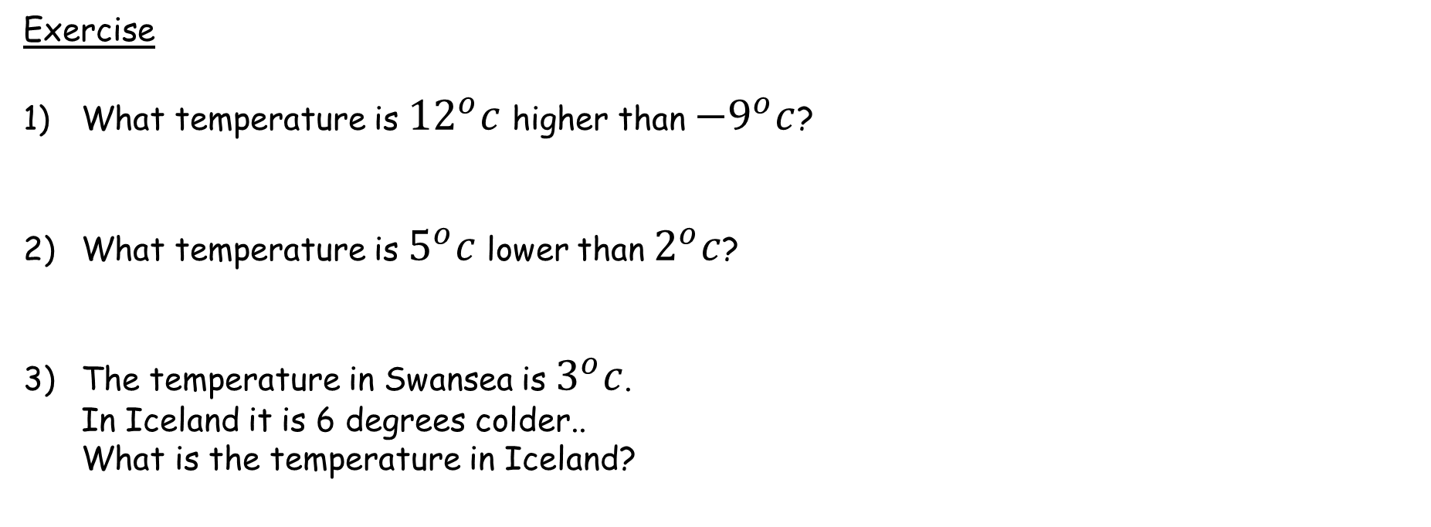
Numeracy strand:
Solving a simple problem involving both a positive and negative temperature
Exercise
What temperature is ${12}^{o}c$ higher than ${−9}^{o}c$?
What temperature is $5^{o}c$ lower than $2^{o}c$?
The temperature in Swansea is $3^{o}c$. In Iceland it is 6 degrees colder.. What is the temperature in Iceland?

