Slide 1
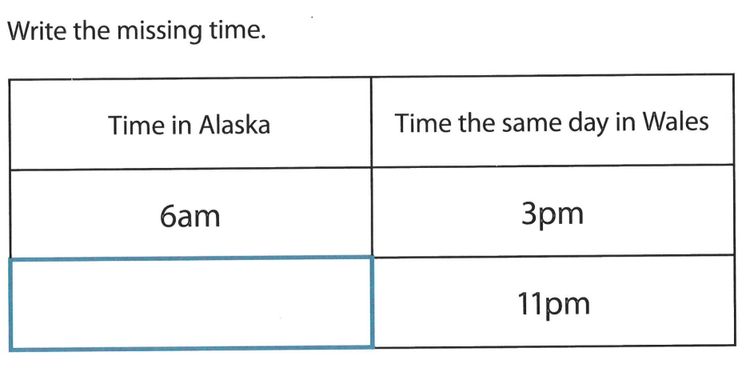
Numeracy strand:
Using and interpreting time zones
Exercise

