Slide 1
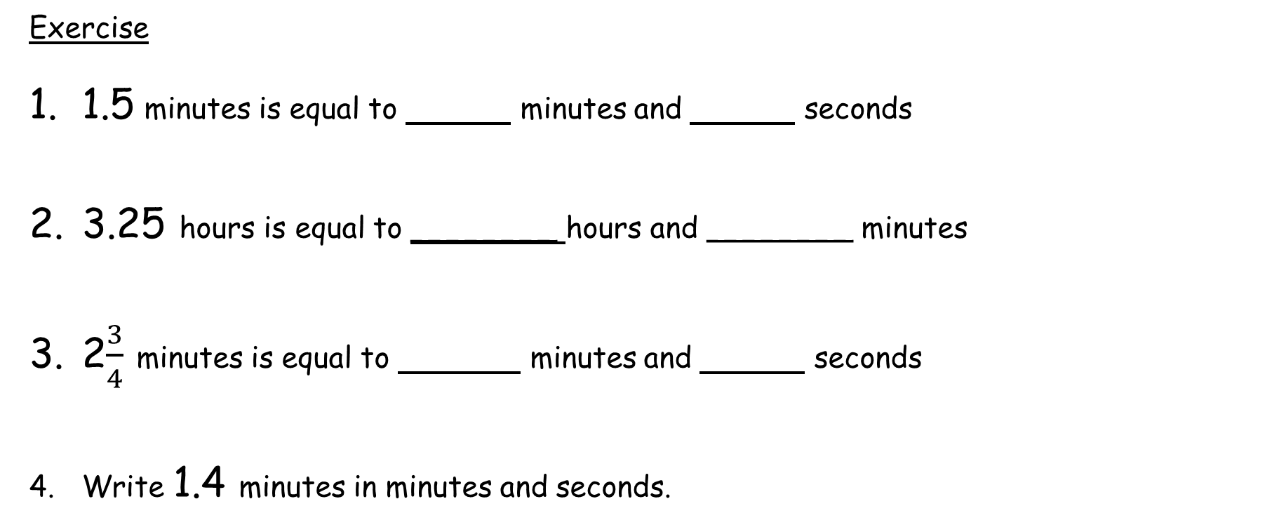
Numeracy strand:
Interpreting fractions of seconds, minutes or hours.
Exercise
1.5 minutes is equal to minutes and seconds
3.25 hours is equal to ________ hours and ________ minutes
2$\frac{3}{4}$ minutes is equal to minutes and seconds
Write 1.4 minutes in minutes and seconds.

