Slide 1
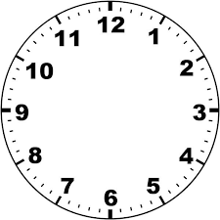
Numeracy strand:
Finding a simple time interval
Example
1) 2)
A TV show starts
A TV show ends
A meeting starts
A meeting ends
How many minutes was the TV show on for?
In minutes, how long did the meeting last?

