Slide 1

Core Theme 5
What will I learn?
Beth fyddai’n dysgu?
Core Theme 5-Weather, Climate and Ecosystems
Natural causes of climate change
Evidence of climate change
Climate graphs and how to analyse them
Calculating temperature range, total annual rainfall and total annual average rainfall
Calculating percentages
Climate types-Tropical, tundra, Savanna and Temperate
How climate zones are directly linked to the ecosystem that exists within them
How animals and vegetation has adapted to life in the Tropical Rainforest
The nutrient cycle
Food webs
How human activity affects biodiversity
Geography/Daearyddiaeth
Name…………………………………….………………………..

Slide 2
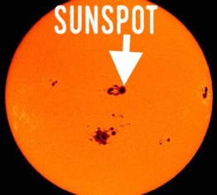

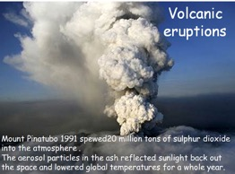
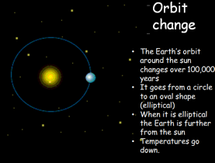
Natural causes of climate change
There are a few things that occur completely naturally that will change the Earth’s climate and have happened for 1000s of years: Sun Spots, Volcanic eruptions and The shape of the Earth’s orbit.
1. Read the information table over the page, then summarise the information on each natural cause of climate change in the spaces below. Use the video links to help you.
Sun Spots
What is a sunspot? What do sunspots do to the Earth’s temperature?
……………………………………………………………………………………………………………………………………………………………………………………………………………………………………………………………………………………………………………………………………………………………………………………………………………………………………………………………………………………………………………..
Volcanic eruptions-Aerosol particles
How do volcanic eruptions affect atmospheric temperatures? Make notes
……………………………………………………………………………………………………………………………………………………………………………………………………………………………………………………………………………………………………………………………………………………………………………………………………………………………
Obliquity, eccentricity and precession
http://www.youtube.com/watch?v=aKpTN8cMJ7M
How do each of these work and what causes in temperature do they cause?
………………………………………………………………………………………………………………………………………………………………………………………………………………………………………………………………………………………………………………………………………..
………………………………………………………….………………………………………………………………………………………………………………………………………………………………………………………………………………………………………………………………………………………………………………………………………………………………………………………………………………………………………….…..…..

Slide 3
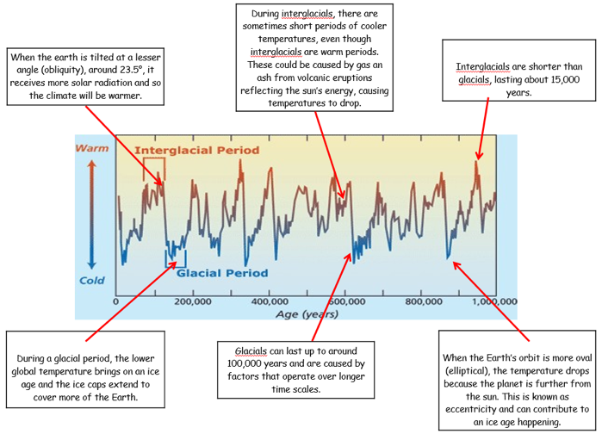
Theory | What is it? | What does it do to Earth’s temperatures?
Sun Spot theory | Some areas of the surface of the sun are cooler than the rest-these are called sun spots. They can be around 1,600ºC cooler. This means the rest of the sun is producing more energy to maintain its temperature of around 6000ºC. | When there are lots of sun spots, the Earth’s temperature will be warmer as the sun is producing more energy to compensate for the cooler spots, heating the Earth more.
Eruption theory | Aerosol particles from volcanic eruptions reflect solar radiation back out to space | Less solar radiation reaching the Earth’s surface means cooler temperatures. This effect lasts usually for only a few months, up to a year maximum.
Earth’s orbital changes- Eccentricity (orbit) | The shape of the Earth’s orbit around the sun changes to become more oval every 100,000 years | The more oval the orbit, the further the Earth is from the sun, the lower the temperature becomes
Earth’s orbital changes- Obliquity (tilt) | The degree to which the Earth is tilted away from or towards the sun changes every 41,000 years | The greater the tilt away from the sun, the less solar radiation reaches the Earth’s surface, the lower the temperature
Earth’s orbital changes- Precession (wobble) | The Earth wobbles on its axis as it spins. The amount of wobble changes every 23,000 years | The greater the wobble, the cooler the Earth’s temperature
How does this explain glacials and interglacials exactly?

Slide 4
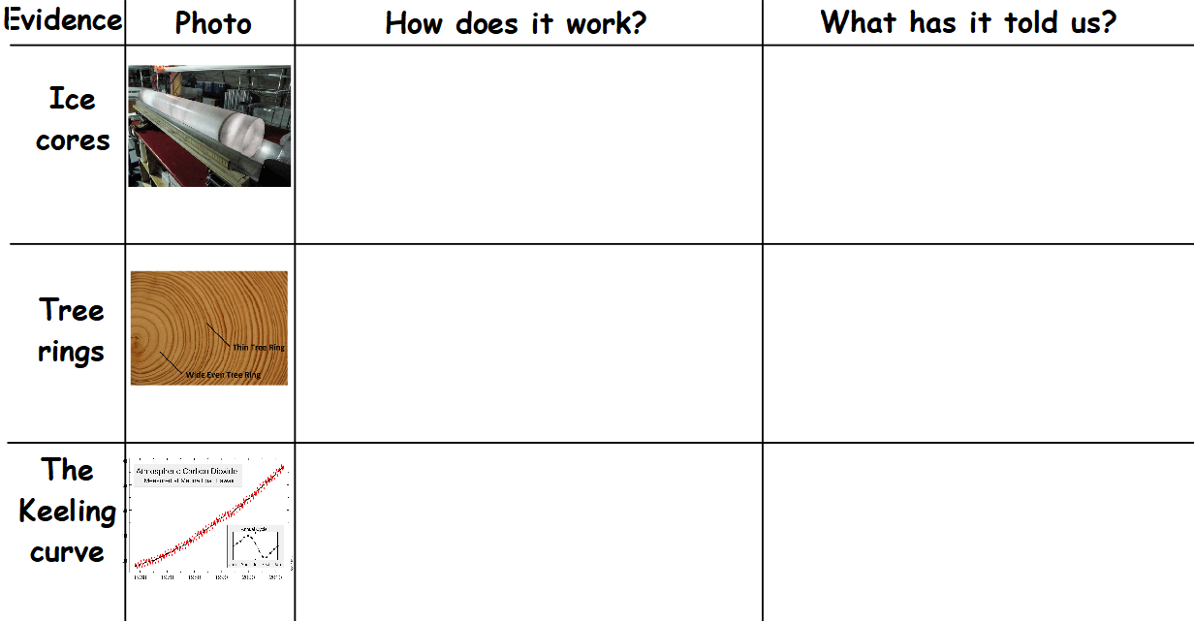

Slide 5
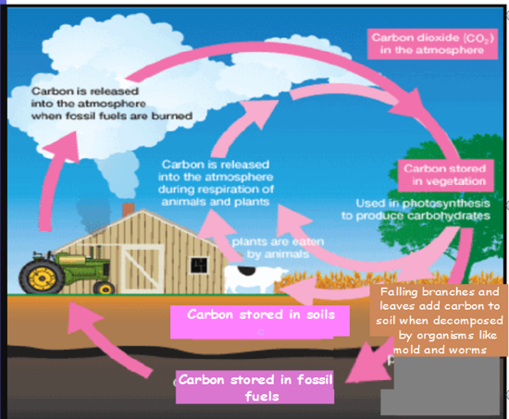
Human causes of climate change
The carbon cycle
Carbon is found in almost all living things, as well as some non living things (like the soil, coal and oil).
Carbon is moved through the environment by the processes shown in this diagram.
Human activity can disrupt the carbon cycle. If too much carbon is released as carbon dioxide, it will add to global warming and cause climate change.
The two main human activities that will disrupt the carbon cycle include: Deforestation and burning fossil fuels.
1. Name 2 natural carbon stores:
………………………………………………………………………………………………………………………………………………
2. Give 1 way in which Carbon dioxide is released NATURALLY in to the atmosphere:………………………………………………………………………………………………………………………
3. Explain how deforestation causes climate change
……………………………………………………………………………………………………………………………………………………………………………………………………………………………………………………………………………………………………………………………………………………………………………………………………………………………………………………………………………………………………………………………………………………………………………………………...4. Explain how burning fossil fuels causes climate change ……………………………………………………………………………………………………………………………………………………………………………………………………………………………………………………………………………………………………………………………………………………………………………………………………………………………………………………………………………………………………………………………………………………………………………………………….

Slide 6
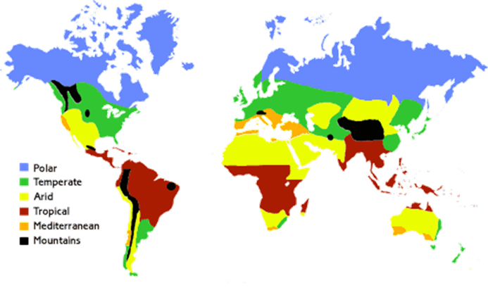
Climate zones and ecosystems
Explain the characteristics of 4 main climate zones (Tropical, Polar, Arid (Savanna) and Tundra) using your knowledge of the atmospheric circulation (see diagram over the page)
Tropical climate is hot and wet all year without distinct seasons because...............
………………………………………………………………………………………………………………………………………………………………………………………………………………………………………………………………………………………………………………………………………………………………………………………………………………………………………………………………………………………………………………………………………………………………………………………………………………….
Arid (Savanna) climate is hot and has two distinct seasons (a long, dry season and a wet season) because………………………………………………………………………………………………
………………………………………………………………………………………………………………………………………………………………………………………………………………………………………………………………………………………………………………………………………………………………………………………………………………………………………………………………………………………………………………………………………………………………………………………………………………….

Slide 7
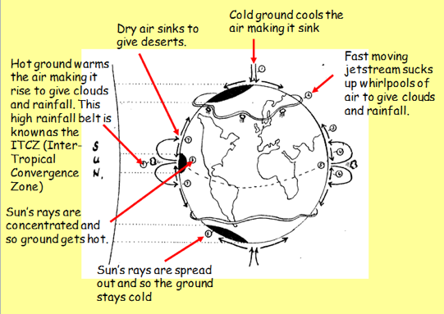
Key
Tropical (warm and wet)
Desert (hot and dry)
Temperate (mild and quite wet)
Polar (cold and dry)
Polar climate is cold and dry all year without distinct seasons because...............
………………………………………………………………………………………………………………………………………………………………………………………………………………………………………………………………………………………………………………………………………………………………………………………………………………………………………………………………………………………………………………………………………………………………………………………………
Tundra climate is dry and has two seasons (a slightly warmer, short summer and a long cold winter) because……………………………………………………………………………..……
……………………………………………………………………………………………………………………………………………………………………………………………………………………………………………………………………………………………………………………………………………………………………………………………………………………………………………………………………………………………………………………………………………………….……………………………………
What is the link between climate zones and ecosystems?
The climate of an area directly affects what can grow there and live there-plants and animals become perfectly adapted to the climate zone that they live in to create unique ecosystems. Over the page are resources sheets on 3 ecosystems-highlight key points then summarise the information on each climate type and its associated ecosystem in to the table a few pages on.

Slide 8
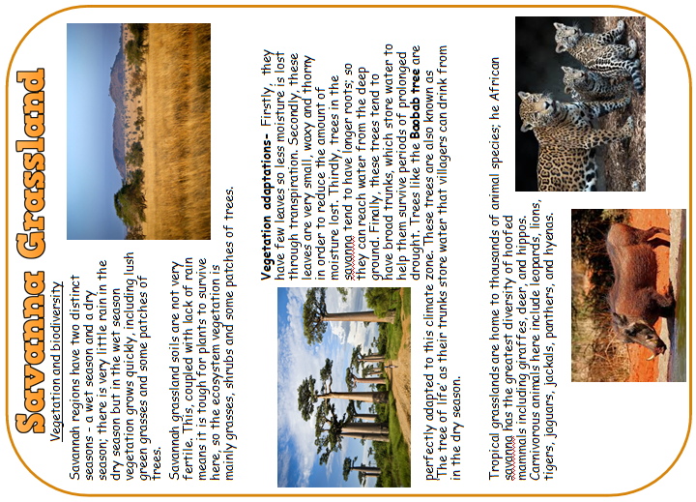
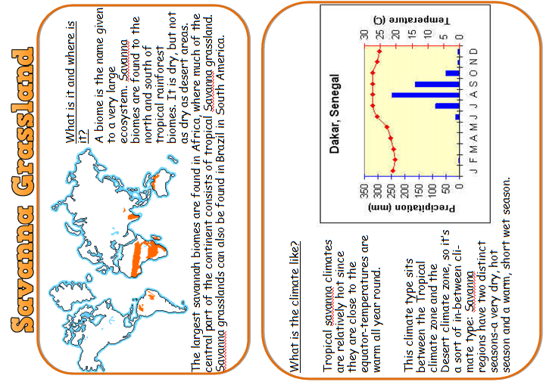

Slide 9
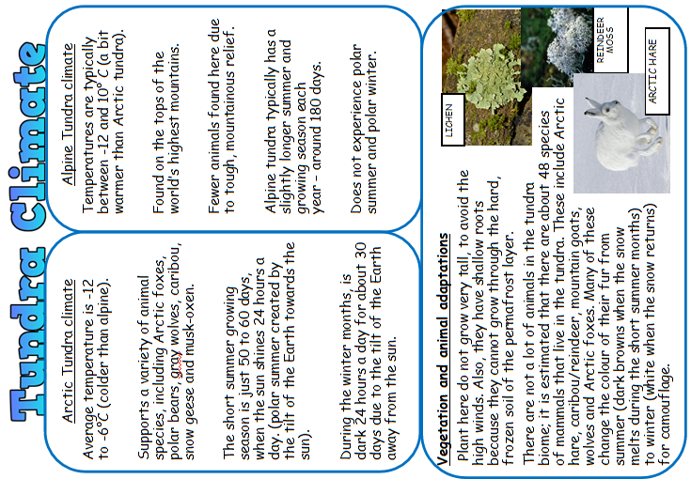
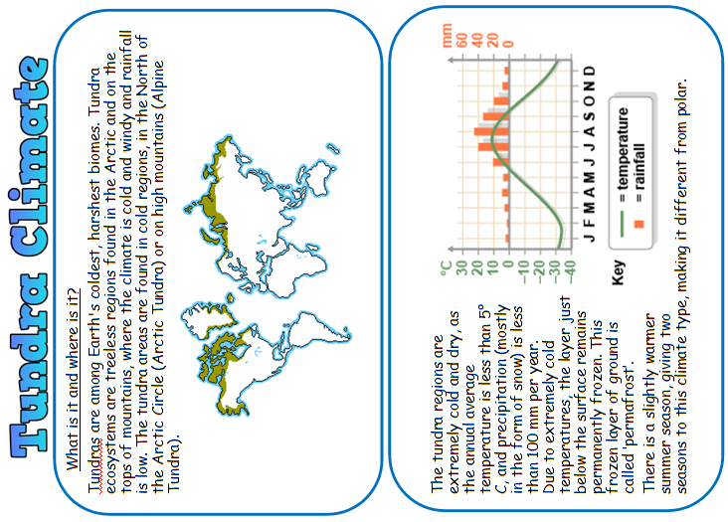

Slide 10
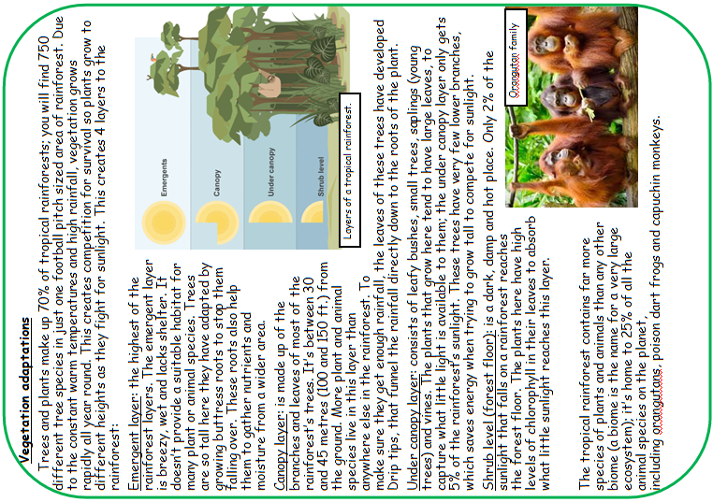
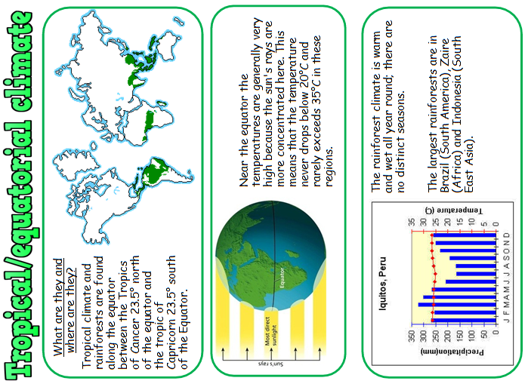

Slide 11
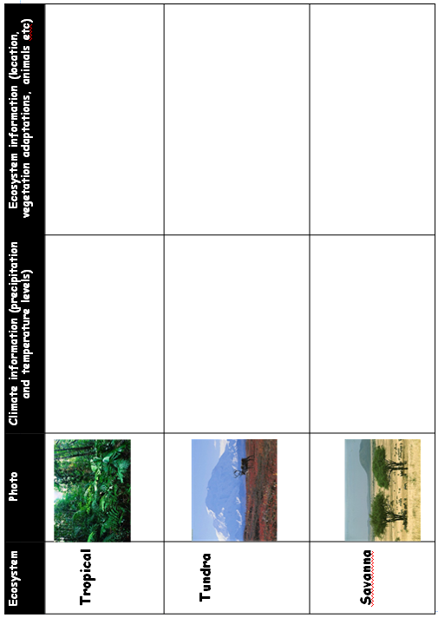

Slide 12
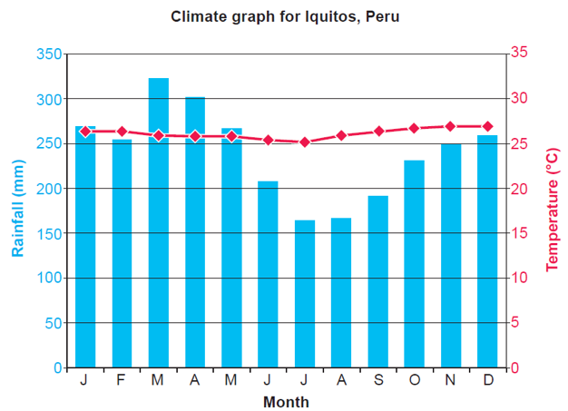
Climate graph skills
Total- Add them all up
Total average-add them all up first, then divide by the number of values you have
Range-The difference between the highest and lowest value
1. Calculate the total annual rainfall for Iquitos, Peru. Show your workings.
………………………mm
2. Calculate the total annual rainfall for Iquitos, Peru. Show your workings.
……………………..mm
3. Calculate the annual range of rainfall and the annual range of temperature for Iquitos, Peru. Show your workings.
…………………………..mm ………………………..ºC.

Slide 13
Calculating percentage from given data sets
How to calculate a percentage- when asked to calculate the percentage of a given group against the whole, this is what you need to do:
Step 1-You take the second figure and divide it by the first e.g 54 ÷ 335=0.16 (2dp)
 | Total number of people in the population (thousands) | Number of people of ethnic minority in the population (thousands) | Percentage
Cardiff | 335 | 54 | 16%
Swansea | 246 | 19
Carmarthen | 15 | 7
Pembroke | 9 | 2
Step 2-You take that answer and multiply it by 100 to turn it into a percentage e.g 0.16 × 100 = 16% (round to a whole number)
Repeat these steps to fill in the rest of the table.
Nutrient cycling in different climates and ecosystems
The nutrient cycle is nature’s recycling system; it cycles nutrients (goodness) from living to dead things and back again.
The nutrient cycle will vary depending what ecosystem you are in-a forest in the UK would have a smaller biomass store and larger litter store than a rainforest system because the differences in climate between those two areas means things happen at different speeds and in different ways.
Look at the different nutrient cycles over the next couple of pages-The tropical rainforest one has been annotated for you to revise from. Look at the other nutrient cycles and answer the questions.

Slide 14
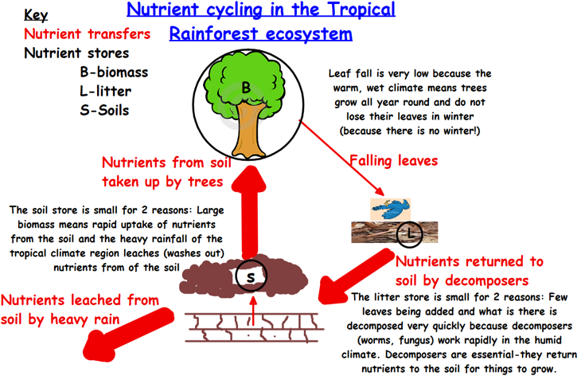
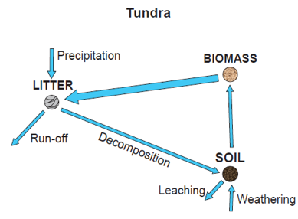
The biomass store in the Tundra nutrient cycle is smaller because…………………………………………….
………………………………………………………………………………………………………………………………………………………………………………………………………………………………………………………………………………………………………………………………………………………………………………
The rate of decomposition in the Tundra nutrient cycle is slower because
………………………………………………………………………………………………………………………………………………………………………………………………………………………………………………………………………………………………………………………………………………………………………………………………………………………………………………………………
The rate of leaching in the Tundra nutrient cycle is slower because
………………………………………………………………………………………………………………………………………………………………………………………………………………………………………………………………………………………………………………………………………………………………………………………………………………………………………………………………

Slide 15
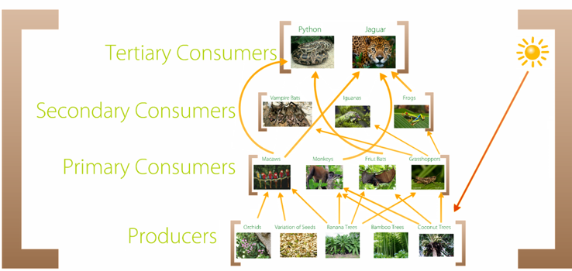
Food webs
Explain how the following human activities could impact on the food web:
Hunting of the Jaguar for its fur:
……………………………………………………………………………………………………………………………………………………………………………………………………………………………………………………………………………………………………………………………………………………………………………………………………………………………………………………………………………………………………………………………………………………………………………………………………………………………………………………………………………………………..............…………………………………………………………………………………………………………………………………………………………..........................................................................................................................................................................................................................................................................................................................................................................
A disease brought in by man that wipes out the fruit trees (coconut and bananas) and orchids:
………………………………………………………………………………………………………………………………………………………………………………………………………………………………………………………………………………………………………………………………………………………………………………………………………………………………………………………………………………………………………………………………………………………………………………………………………………………………………………………………………………………….................…………………………………………………………………………………………………………………………………………………………………………………………………………………………………………………………………………………………………………………………………………………………………………………………………………………………………………………………………………………………………………………………………………………………………………………………………………………………………………………………………………………………......................................................................................................................................................................................................................................................................................................................................................................

Slide 16
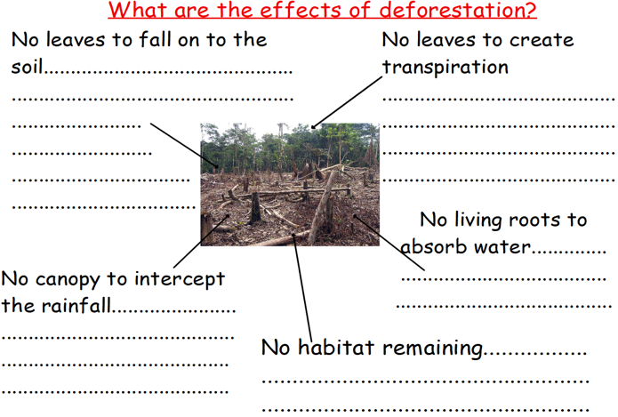
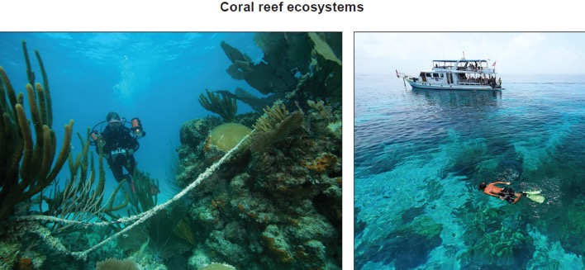
Impact of human activity on ecosystems and biodiversity
Suggest why biodiversity is suffering in ecosystems such as coral reefs.
……………………………………………………………………………………………………………………………………………………………………………………………………………………………………………………………………………………………………………………………………………………………………………………………………………………………………………………………………………………………………………………………………..……………………………………………………………………………

Slide 17
Core Theme 6
What will I learn?
Beth fyddai’n dysgu?
Core Theme 6-Development and Resource issues
Measuring development-GDP
MNCs-Multi-National Companies-what are they and how do they affect development?
Tourism-benefits and disadvantages of tourism in NICs/LICs
The concept of Fair Trade and how it can help LIC and NIC communities.
Water consumption-Why is demand for water increasing? Population growth, consumerism and changes to agricultural practices
Patterns of regional social and economic inequality-within a country, why are there richer and poorer areas?
Reducing regional inequality-Using policies and investment to create economic growth in deprived regions of LICs and HICs.
Geography/Daearyddiaeth

Slide 18
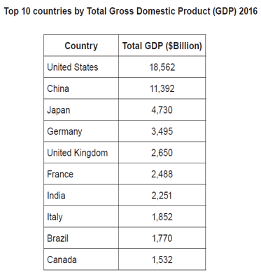
Measuring development-GDP
There are many ways of measuring development, but the most common is the economic indicator, Gross Domestic Product (GDP). It is calculated by adding up the value of all of the goods and services produced by a country and dividing it by the number of people in the population to give an average figure.
Ranking countries in order of GDP is known as the continuum of economic development.
What are the limitations of using this indicator to measure development?
………………………………………………………………………………………………………………………………………………………………………………………………………………………………………………………………………………………………………………………………………………………………………………………………………………………………………………………………………………………………………………………………………………………………………………………………………………………………………………………………………………………………………………………………………………………………………………………………………………………………………………………………………………………………..……..……
There are other indicators that you could use-what do they tell you about a country’s level of development?
Literacy rate-………………………………………………………………………………………………………………………………………………………………………………………………………………………………………………………………………………………………….
Life expectancy-
…………………………………………………………………………………………………………………………………………………………………………………………………………………………………………………………………………………………………Number of cars per household-
………………………………………………………………………………………………………………………………………………………………………………………………………………………………………………………………………………………………….

Slide 19
How does Fair Trade help LIC communities?
Trade happens for 3 reasons:
1. ……………………………………………………………………………………………………………………………………………
2.……………………………………………………………………………………………………………………………………………
3. …………………………………………………………………………………………………………………………………………
However, it is often unfair and keeps the poor countries poor through the use of trading blocks, quotas and tariffs.
Fair Trade helps to reduce this.
4. What is Fair Trade?
……………………………………………………………………………………………………………………………………………………………………………………………………………………………………………………………………………………………….
How does Fair Trade help LIC communities?

Slide 20
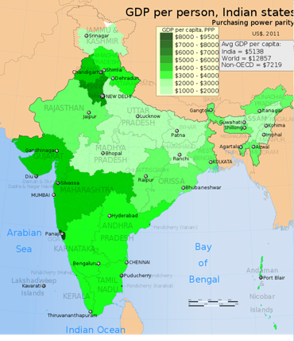
Tourism in an NIC-India
Name this mapping technique …………………………………………………………………………………..…………………………………………
Give one way in which the map could be adapted so that it’s easier to understand
…………………………………………………………………………………………………………………………………………………………….…………………………………………………………………………………………………………………………………………………………….....
Advantages of tourism for India

Slide 21
Disadvantages of tourism for India
Enclave tourism-tourism that takes place in a space that is separate from its surroundings e.g a beach resort area and all its facilities are closed off to locals and used only for tourists

Slide 22

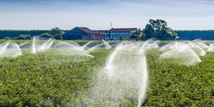
Water-why is demand increasing?
Population growth
Agricultural change

Slide 23
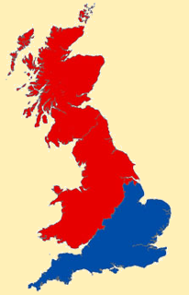
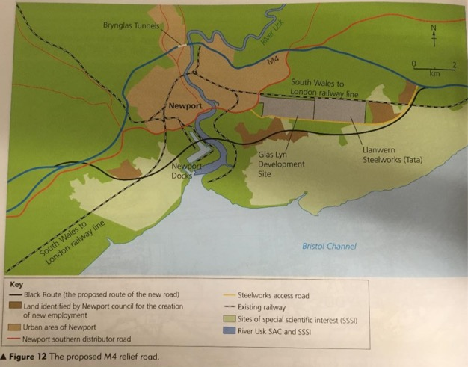
Regional differences in development in an HIC
There exists within the UK a divide between the North and the South (although notice from the map that it does not actually geographically go through the middle!)
This has been created over time as the area around London and the surrounding motorways became more affluent and the rest of the UK, including Wales has struggled to keep up due to closing heavy industry e.g coal and steel.
Reducing regional inequalities in an HIC
• The M4 goes from 3 lanes to 2, through the tunnels=congestion
• The area relied on heavy industry-mostly steel-to keep the economy running. This has since closed down causing massive unemployment.
There are new plans for a relief road, that will divert traffic around Newport

Slide 24
Advantages
• No more tunnel congestion=easier access to Cardiff in the West and London in the East for businesses to trade
• People can more easily access jobs in these big cities=more people move in
• More jobs-more income=economy boosted
• People have more disposable income to spend-more shops and businesses move in-even more jobs created-economy boosted-more money for future investment projects-POSITIVE MULTIPLIER EFFECT
Disadvantages
• It cuts through two SSSI sites-endangered species and habitats at risk
• More businesses move in to the area now access has improved-more competition for independent, local businesses-may close down
• More traffic congestion from customers and deliveries=more air pollution=global warming
• It cuts through the port area-disruption to existing import/export businesses
To what extent might projects such as this help to reduce regional inequalities in the future?
………………………………………………………………………………………………………………………………………………………………………………………………………………………………………………………………………………………………………………………………………………………………………………………………………………………………………………………………………………………………………………………………………………………………………………………………………………………………………………………………………………………………………………………………………………………………………………………………………………………………………………………………………………………………..……..…………………….
………………………………………………………………………………………………………………………………………………………………………………………………………………………………………………………………………………………………………... ………………………………………………………………………………………………………………………………………………………………………………………………………………………………………………………………………………………………………………………………………………………………………………………………………………………………………………………………………………………………………………………………………………………………………………………………………………………………………………………………………………………………………………………………………………………………………..
……………………………………………………………………………………………………………………………………………………………………………………………………………………………………………………………………………………………………………………………………………………………………………………………………………………………………………………………………………………………………………………………………………………………………………………………………………………

Slide 25
Optional Theme 8
What will I learn?
Beth fyddai’n dysgu?
Optional Theme 8: Consumerism and its impact on the environment
Eco-footprint
Relationship between eco footprint, GNI and population
E-waste and its impact on the environment
Consumerism and destruction of ecosystems
Managing Natural habitats-Sustainable tourism, conservation projects, national parks and wildlife corridors
How will climate change affect people and the environment both in the UK and globally?
How can we respond to a reduce the risk of climate change both locally, nationally and globally?
Why is it difficult for governments to reduce climate change?
Geography/Daearyddiaeth

Slide 26

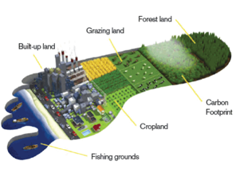
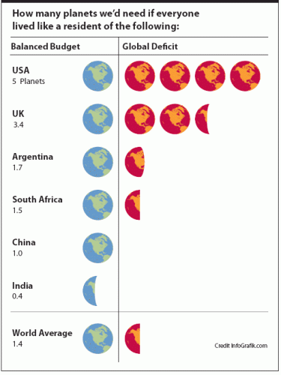
Consumerism and our ecological footprint
What is consumerism?
………………………………………………………………………………………………………………………………………………………………………………………………………………………………………………………………………………………………………………………………………………………………………………………………………………
What is our ecological footprint? what factors are used to calculate it?
………………………………………………………………………………………………………………………………………………………………………………………………………………………………………………………………………………………………………………………………………………………………………………………………………………………………………………………………………………………………
Suggest reasons why HICs tend to have larger ecological footprints
………………………………………………………………………………………………………………………………………………………………………………………………………………………………………………………………………………………………………………………………………………………………………………………………………………
…………………………………………………………………………………………………………………………………………………………………………………………………………………………………………………………………………
………………………………………………………………………………………………………………………………………………………………………………………………………………………………………………………………………………………………………………………………………………………………………………………………………………………………………………

Slide 27
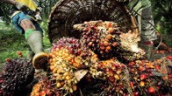
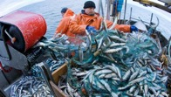
Issues with increasing consumerism-
ecosystem destruction and waste
Deforestation to make way for palm oil production
………………………………………………………………………………………………………………………………………………………………………………………………………………………………………………………………………………………………………………………………………………………………………………………………………………………………………………
………………………………………………………………………………………………………………………………………………
………………………………………………………………………………………………………………………………………………
Overfishing to meet demand as diets improve
………………………………………………………………………………………………………………………………………………………………………………………………………………………………………………………………………………………………………………………………………………………………………………………………………………………………………………
…………………………………………………………………………………………………………………………………………………………………………………………………………………………………………………………….………………………………
The more we consume, the more waste is created. Advances in affordable technology have led to a rise in a new type of waste E-Waste. Your old phone, tablet etc these all contain various metals that are valuable when recycled, including gold and copper. However, they also contain hazardous materials-mercury and lead-that are poisonous to the environment and people.
Impact of E Waste on people and the environment

Slide 28
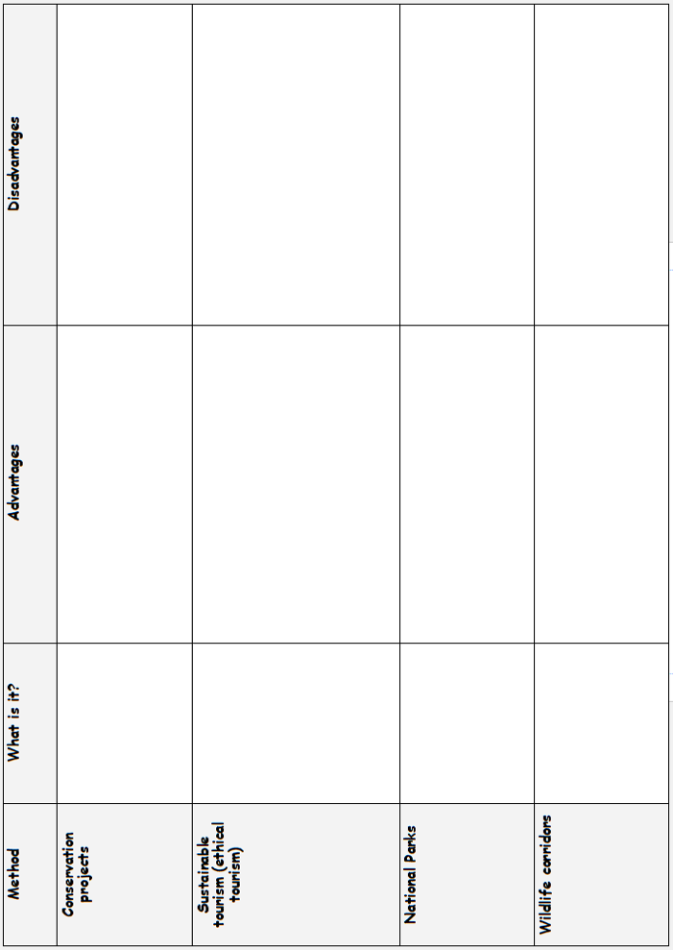
Managing natural environments
We need to find a way to allow manage natural habitats sustainably in the face of the challenges they face from consumerism.

Slide 29
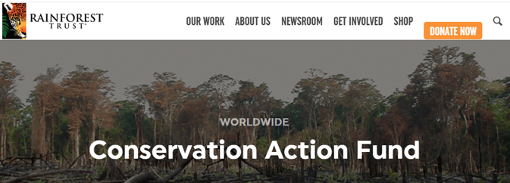
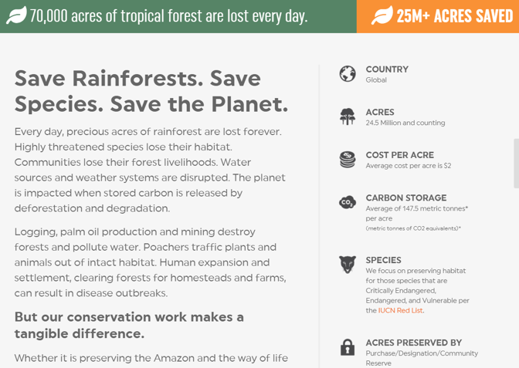
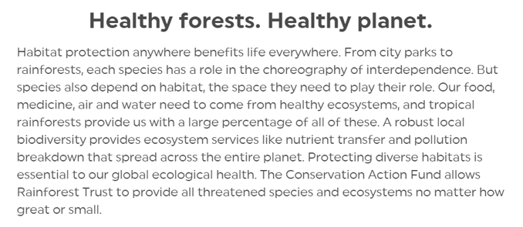
However, conservation projects can be difficult in LICs due to lack of government cooperation; they would rather spend the money needed to fund conservation on projects to improve infrastructure and make more money for the economy. In addition, the problem of illegal poaching of species we are trying to conserve is difficult to police over large areas such as the Amazon and with little funding in LICs.

Slide 30
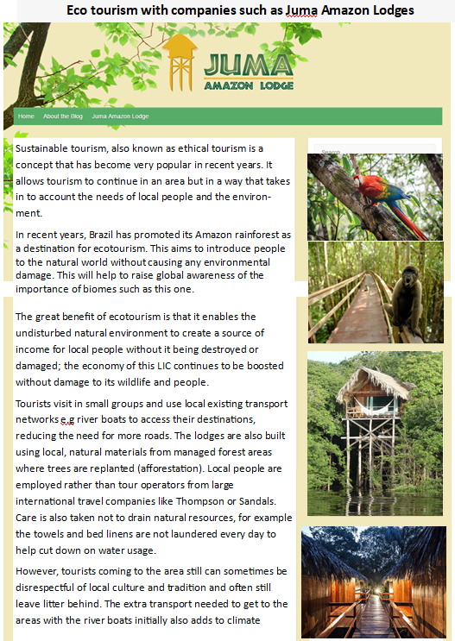

Slide 31
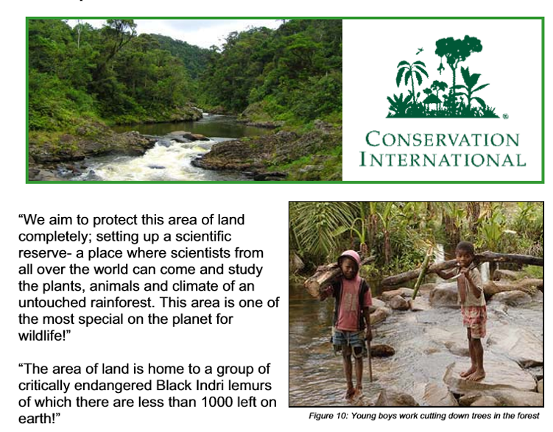
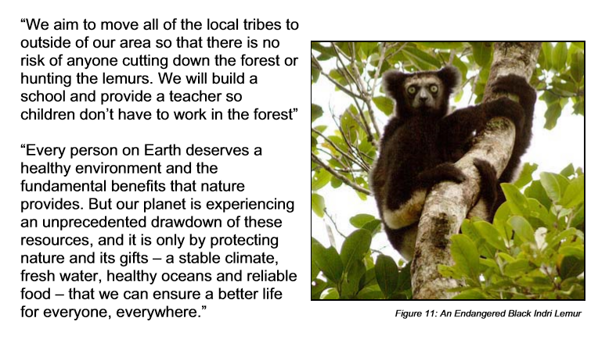
National Parks Programme
The protection afforded by an area being made in to a National park means that species numbers can recover and biodiversity is restored. In addition, tribal cultures that have been unchanged for centuries remain untouched.
However, the level of protection means there is little to no human development or activity allowed in the area at all, which can mean less money is made for the economy of LICs that use this approach.

Slide 32
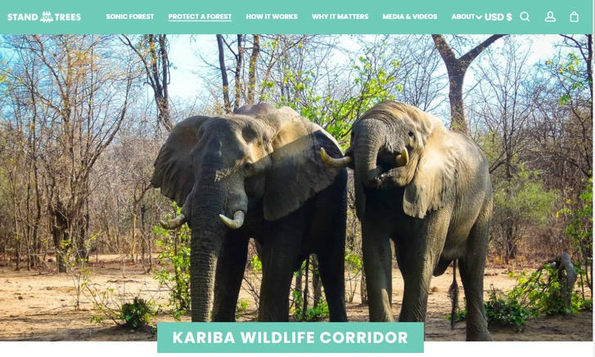
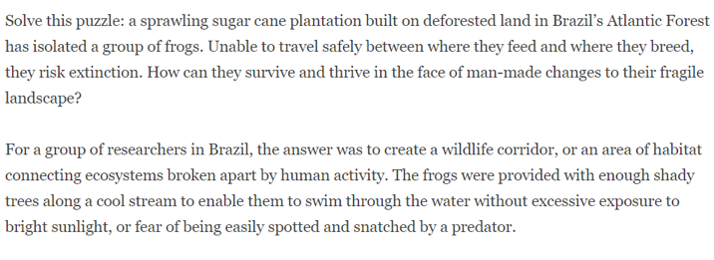
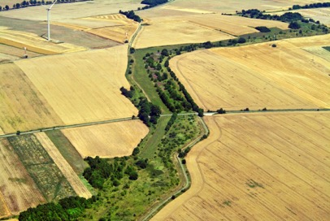
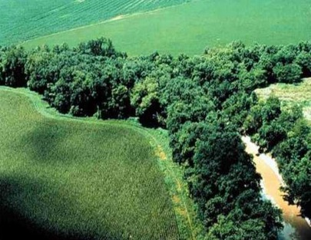
As more and more rainforest is cut down to make way for urban sprawl and agriculture, the remaining patches of forest become cut off from each other. This means that species are now isolated-they cannot breed between patches to maintain diversity and it is likely there will be conflict for food, water and territory within the small
remaining patches. Both of these could lead to species extinction.
Be leaving, or replanting strips of forestry between these isolated patches, it means animals can now travel between them without having to venture across open farmland.
However, replanting projects can sometimes fail in LICs due to lack of funding and cooperation and leaving land for corridors means less profitable land for LIC farmers, reducing their income.

Slide 33
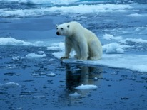
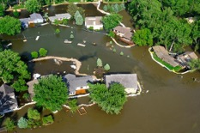
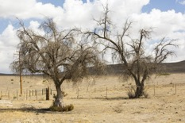
Effects of Climate change
Suggest 3 ways in which the environment can be impacted by global warming.
Use evidence from the photographs.
………………………………………………………………………………………………………………………………………………………………………………………………………………………………………………………………………………………………………………………………………………………………………………………………………………………………………………………………………………………………………………………………………………………………………………………………………………………………………………………………………………………………………………………………………………………………………………………………………………………………………………………………………………………………..……..…………………………………………………………………………………………………………………………………………………………………………………………………………………………………………………………………………………………..……..……
Tackling Climate change
Read the information on the next page and highlight the key points-why do Governments find it so difficult to tackle climate change?
………………………………………………………………………………………………………………………………………………………………………………………………………………………………………………………………………………………………………………………………………………………………………………………………………………………………………………………………………………………………………………………………………………………………………………………………………………………………………………………………………………………………………………………………………………………………………………………………………………………………………………………………………………………………..……..…………………………………………………………………………………………………………………………………………………………………………………………………………………………………………………………………………………………………………………………………………………………………………………………………………………………………………………………………………………………………………………………………………………..…………………………………………..……..……

Slide 34
Global response-the Paris Agreement
The Paris Agreement (also known as COP21) is an agreement signed up to by 195 countries in 2015 to reduce their greenhouse gas emissions and waste. The problem with previous agreements like this was, all countries were set the same targets, whether you’re a HIC, NIC or LIC.
The COP21 is different; each country has its own individual targets set for it. Many NICs and LICs still rely heavily on industry and power stations to become more developed; give them a chance to catch up before they have to abide by massive greenhouse gas emission reduction targets. NICs and LICs still are expected to reduce emissions, but not by as much as HICs that are already developed, making this agreement much more fair.
The idea with the COP21 is to keep global average temperature increase to below an additional 2°C (it has already risen by 1°C in the last 50 years). The final target date is 2100.
Without the COP21, temperatures are expected to increase by 3.7°C by 2100. The main issue may be that the COP21 is not legally binding, so if countries do not meet their targets, there is no real consequences.
National response-County Council Action Plans
In countries that have signed up the Paris Agreement (COP21), the governments of those countries need to set out a plan on how to meet their carbon emission reduction targets. To do this, they ask local councils in different areas to make a plan and Swansea is no different. Listed below are some of the ways that Swansea City Council are using to try to reduce carbon emissions:
Warmer homes-when building new homes, make sure they are well insulated so they do not need as much energy to heat them
Metro-bus scheme and train line upgrades-to try and encourage people to use more public transport; fewer cars means less air pollution
More cycle lanes-encourage people to cycle/walk; fewer cars means less air pollution
Ensure new public buildings have up to date, energy efficient boilers so less energy is wasted
These all would help to reduce Co²emissions, but some are not very efficient-like the heat network idea– and others can be very expensive-like the metro bus installation and train upgrade scheme. To compensate, people using the service would probable be charged higher ticket prices, so they’d be less likely to use them anyway!

